Slide 1
“Here Am I”
CS60009
SMARTPHONE COMPUTING & APPLICATIONS
Wi-Fi based location identification
Term Project Presentation
Dharmendra Sheshma
Rahul Saxena
Jeslu Celine Jacob
Under the mentorship of
Sumitro Bhaumik

Slide 2

Introduction
'Smart environments' are evolving from a luxury to a necessity.
It aids in improving the comfort of users while allowing energy and monetary savings.
An efficient and accurate indoor positioning system is a requirement.

Slide 3

Description
The idea of this project is to use Wi-Fi signals to determine the user location in a house to automate certain tasks.
Objective
To develop an app which can use multiple Wi-Fi-signals to triangulate the user location.

Slide 4
Our contribution
GPS is used for determining location, however
GPS accuracy is low in indoors
GPS sensing consumes a lot of energy
Hence, we propose
A simple Wi-Fi based location identification app
Allowing users to save different locations and receive custom reminders/notifications
Wi-Fi Signal strengths from different access Points
Our App
Location identification
Personal notification

Slide 5
Our Approach
1
App Training Phase
2
Real Time Working
3
Evaluation

Slide 6
Training phase
Wi-Fi Scan
Display SSIDs and signal strength
User selects 3 AP
Based on the requirement –Locate a room/ Locate a small region
Default error – 5
User enters the error factor
Saves the location
User enters the custom notification
Error Factor obtained by taking 95% confidence and taking the maximum allowed offset – Tn-1 alpha/2 X root(var/n) = +- 2.135 * 2.010638 = 4.292713 ~ 5

Slide 7
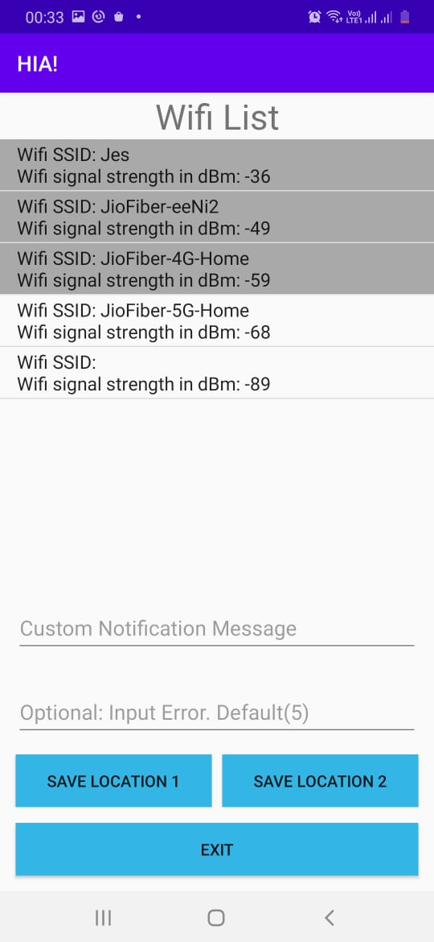
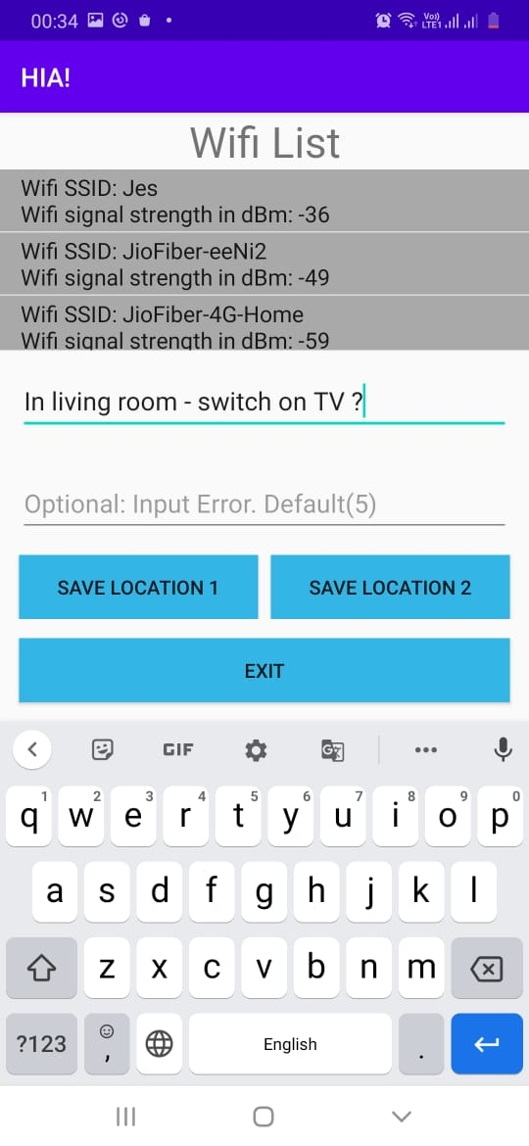
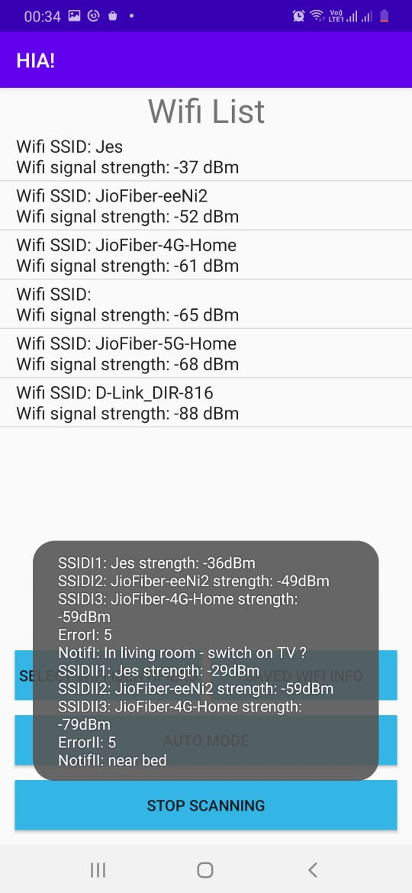
3 selected
Option to view the saved information

Slide 8
Working Phase
Start
Look for 3 SSID for each saved location
If Wi-Fi disabled
Wi-Fi Scan
Toast to enable
Wi-Fi Receiver
Repeated every 5 secs
Look for the signal strength
All 3 present
All within the range
Update the scan results on screen
Was User in the range before
N0
Send notification

Slide 9
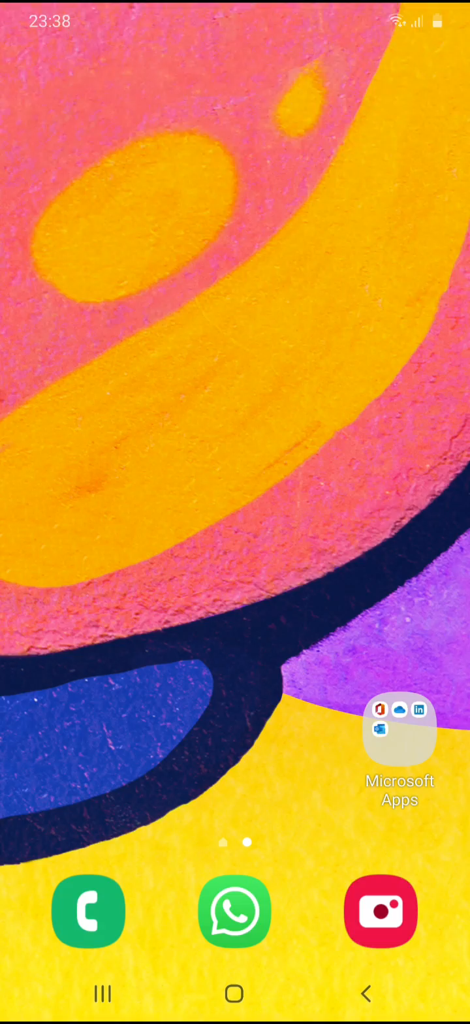


Demo of App Training
Demo of Locating
Demo of differentiating

Slide 10
Evaluation
To measure the overall accuracy
14 people were asked run the app at their home
Each saved a location with default error factor
They then moved in and out on the room 10 times and reported the no. of times
The location was detected correctly – True Positive
The app identified a wrong location - False Positive
No Notification when not in the saved location -True Negative
Not identifying the saved location - False Negative

Slide 11
Evaluation
Confusion Matrix
Precision
TP/TP+FP = 0.762237762
Recall
TP/TP+FN = 0.778571429
F1 accuracy
2x(precision x recall)/(precision + recall) = 0.770318021
TP | FN
FP | TN
109 | 31
34 | 106
Precision – 76%
Recall – 77.8%
Accuracy – 77%

Slide 12
Evaluation
Comparing the precision of GPS based location identification and our app in differentiating 2 locations
Method
Loaded a GPS coordinate tracker and our ‘HIA’ app in phone
Took a point as reference point and measured the GPS coordinates and AP RSSI (using our app) for distance 0.6m, 1.2m, 1.8m, and 2.4 m from the reference points.
At each location 5 observations were collected
Two ways of analysing
The points were plotted in 2D using the coordinates for GPS data and in 3D for WiFi data ( 3 Aps)
The difference in values from reference was studied and plotted to find how different the values are as distance between points increases

Slide 13

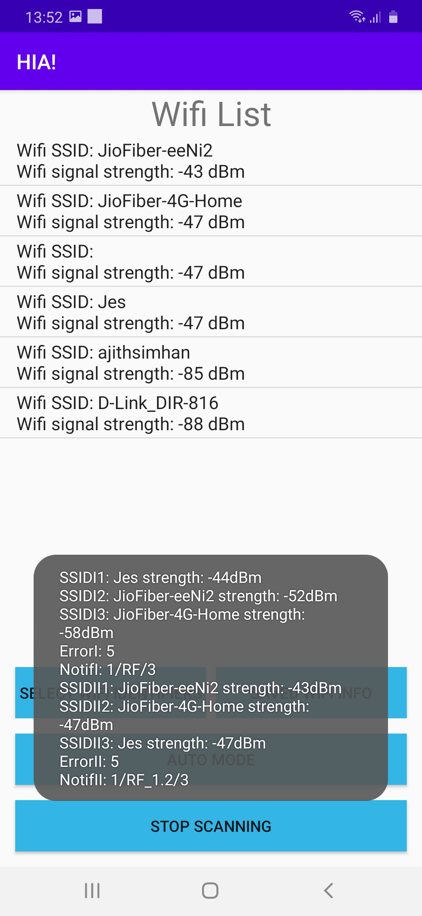
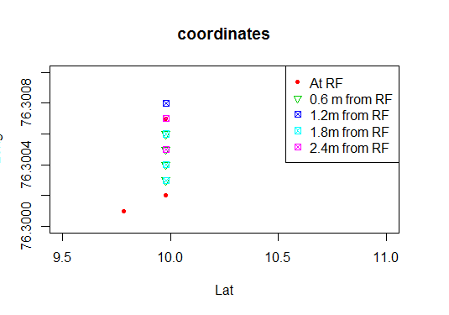
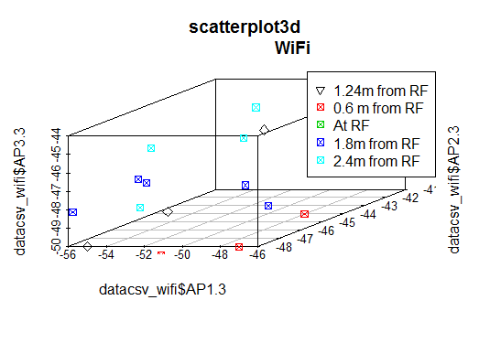
Comparing the precision of GPS based location identification and our app in differentiating 2 locations
In GPS locator several points are coinciding indicating we cannot use them to identify the location
In WiFi locator no point is overlapping.
While considering an error factor 5, we observed that at 1.2 m separation Wi-Fi can detect 2 locations

Slide 14
The absolute difference of distances were measured for each case : at 0.6, 1.2,1.8, 2.4 m
GPS –> abs(lat_ref-lat) + abs(long_ref-long)
Wi-Fi -> abs(AP1_ref-AP1) + abs(AP2_ref-AP2) + abs(AP3_ref-AP3)
The difference was averaged for the 5 observations at each location
The following Table generated
X | GPS | Wi-Fi
0.6 | 0.03908 | 17.4
1.2 | 0.03902 | 25.8
1.8 | 0.03904 | 27.6
2.4 | 0.1563 | 28
Observation:
The difference in Wi-Fi RSSI is more prominent that GPS coordinate difference.
Hence our Wi-Fi based app is more suitable for indoor localisation and it gives more granular localisation

Slide 15
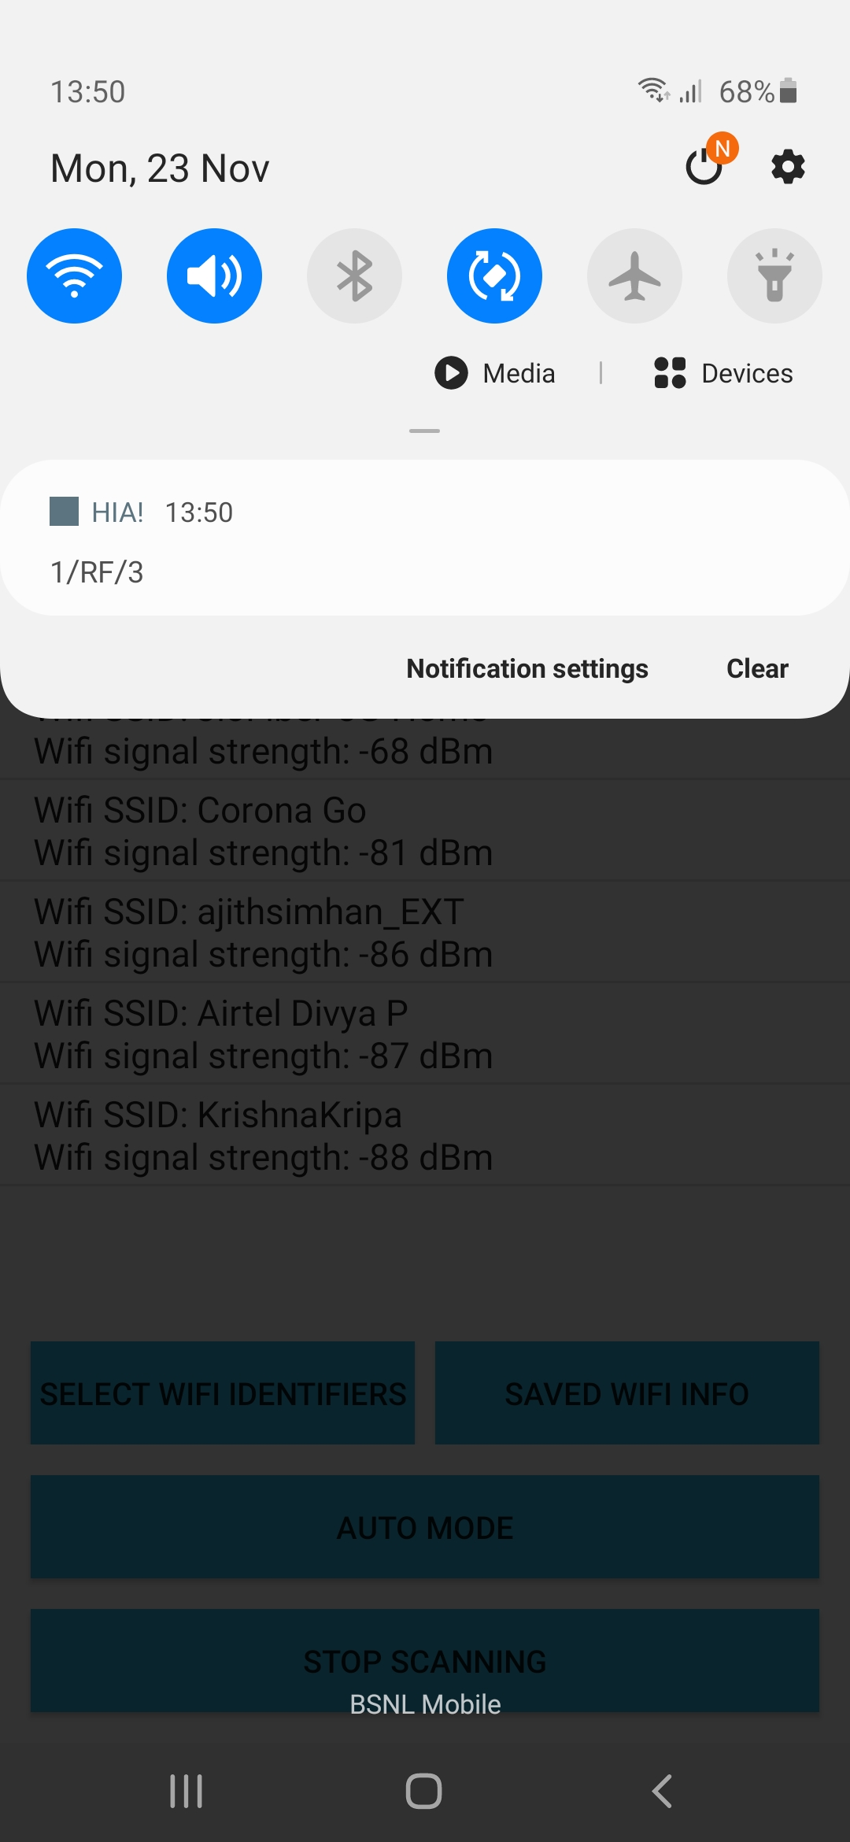
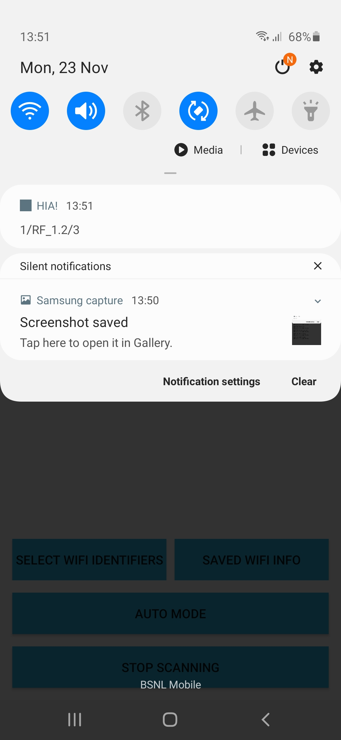

Our app can differentiate between 2 points at 1.2 m

Slide 16
Summary of our App:
Summary of our Evaluation :
Users can save location information, write a custom reminder and view the saved information
The app identifies the location using varying signal strength from 3 Aps
Auto scan mode scans at an interval of 5 secs and notifies the user when the location is identified
When the user is moving around in the same region repeated notifications are avoided
The app has an accuracy of 77%
The app can discriminate between 2 points at a distance of 1.2m
Limitations:
The app only considers 3 access points and it has to be chosen by the user in the training phase
A default error value is set and user needs to manually adjust it through the app depending on the situation
App can save only 2 locations

Slide 17
Thank You

